Slide 1
Multi-Armed Bandit Algorithms
Two categories of MAB algorithms:
Regret minimization
Best arm identification
Regret minimization MAB algorithms:
Maximize payoffs(= minimize regret).
Don't generate statistical significance.
Don't use a control or a baseline experience.
Algorithms will end after a finite time steps and they usually do not output an arm.

Slide 2
Regret Minimization MAB Algorithms
Many algorithms:
Greedy algorithms
UCB algorithms
Gittins index
Softmax learning
Thompson sampling
………
Thompson sampling:
Outperforms other algorithms in terms of regret minimization or payoff maximization in stationary environment. [1]
Bayesian approach
Stationary algorithm
Batch update to account for delayed feedback
Easy to implement and computationally efficient

Slide 3
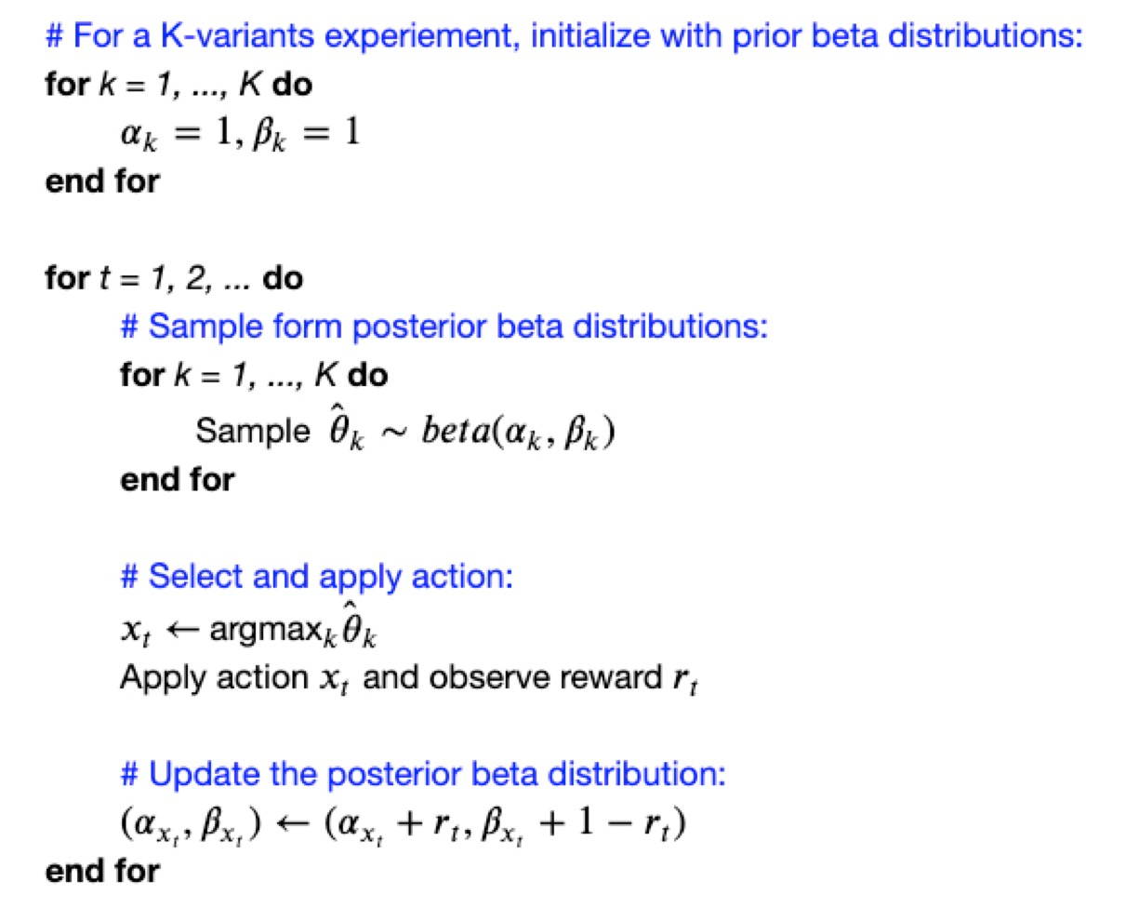
Thompson Sampling - Algorithm

Slide 4
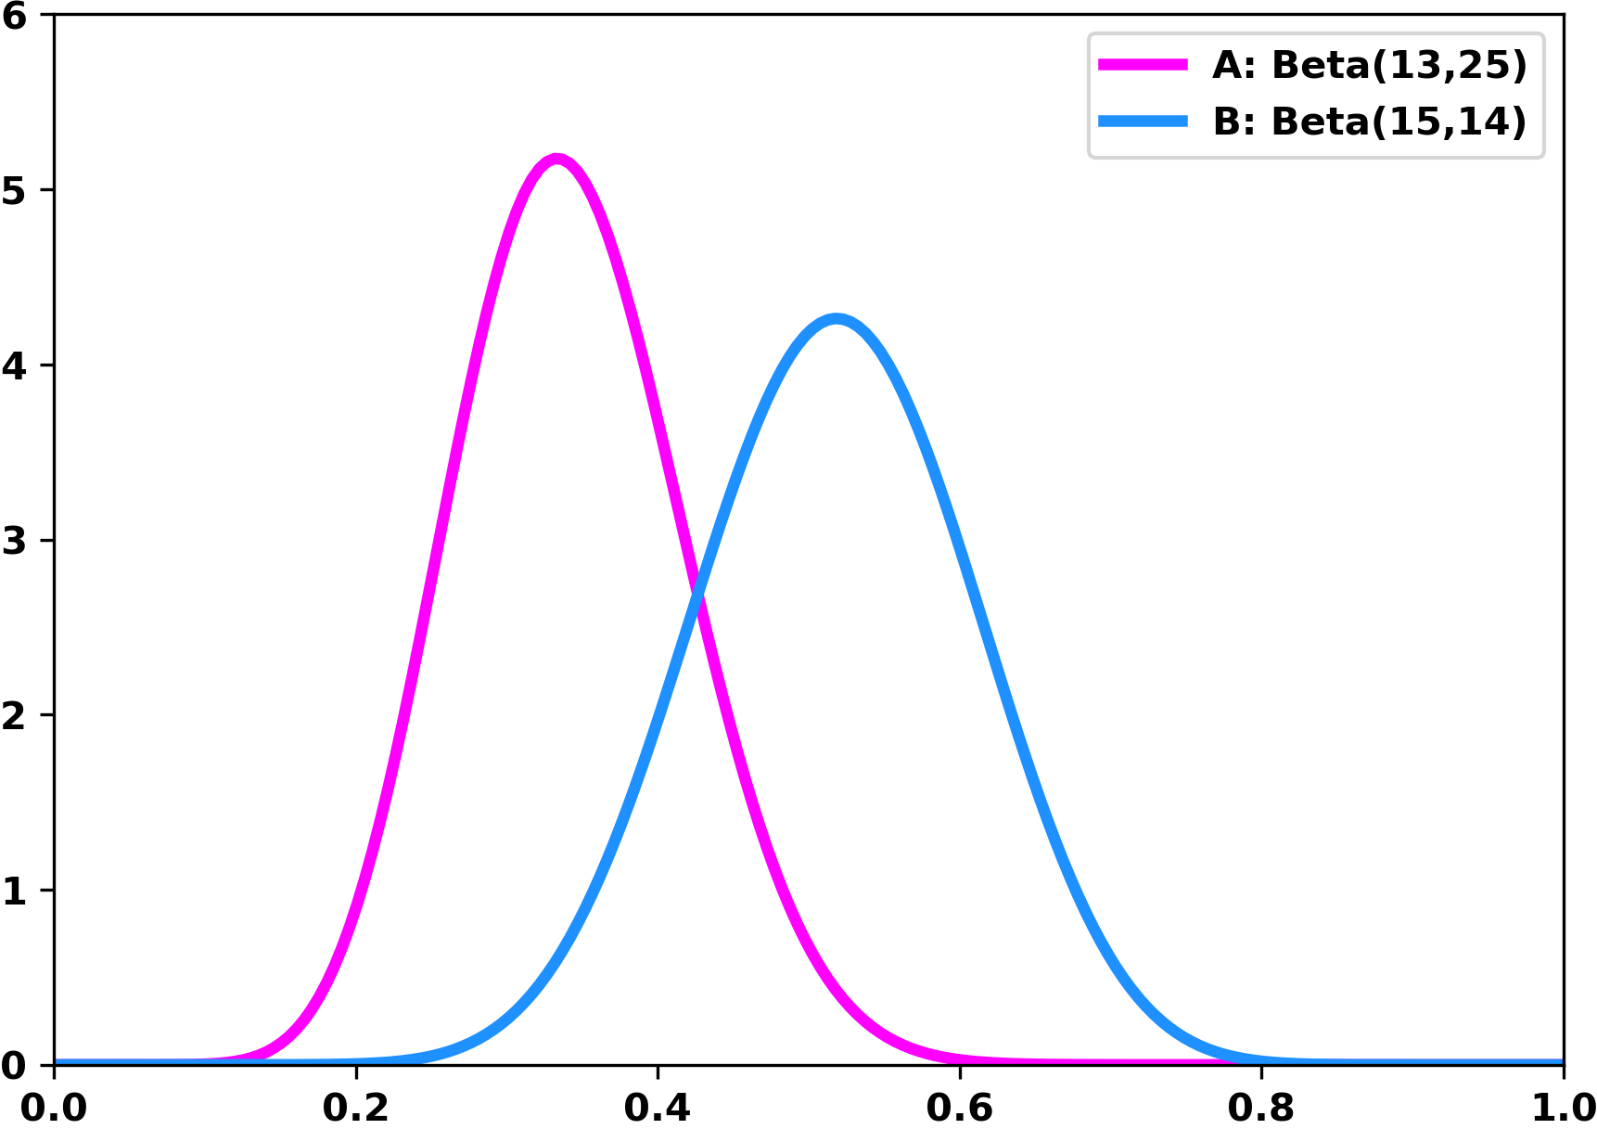
Thompson Sampling – An Example
A
A
B
B
A: 0.31
B: 0.64
B: 0.36
A: 0.56

Slide 5
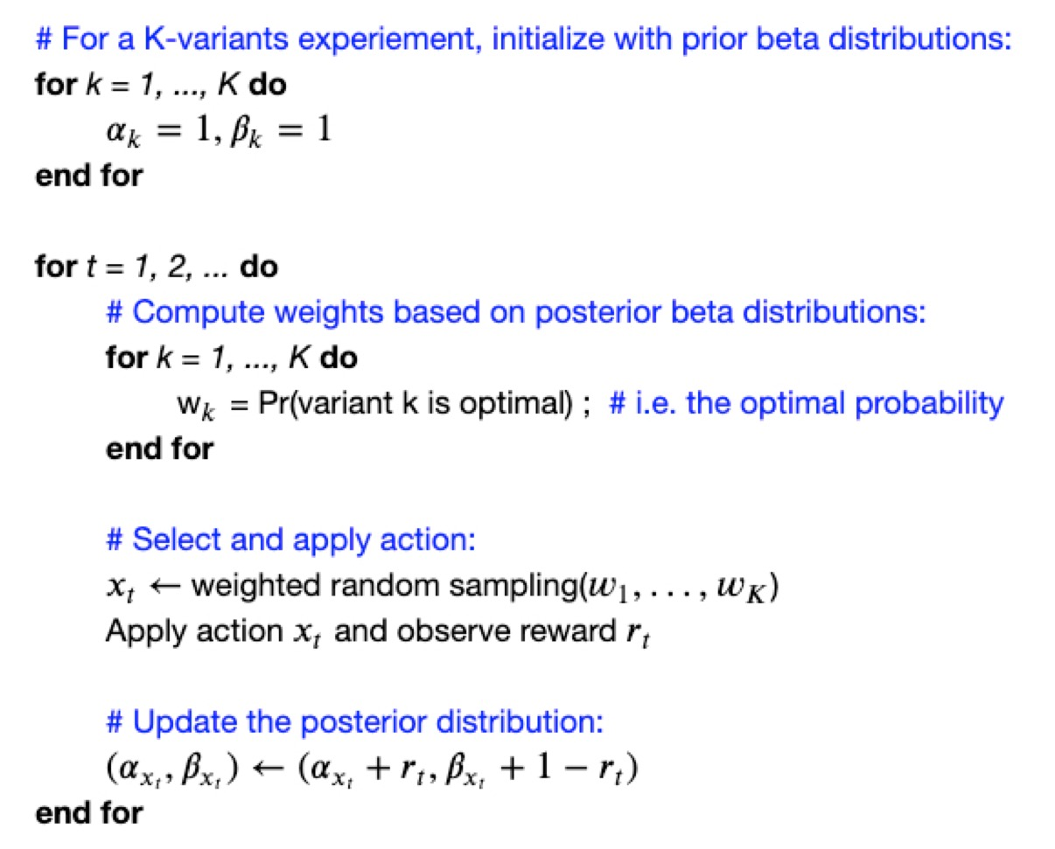
Thompson Sampling – Weighted Random Sampling Version

Slide 6
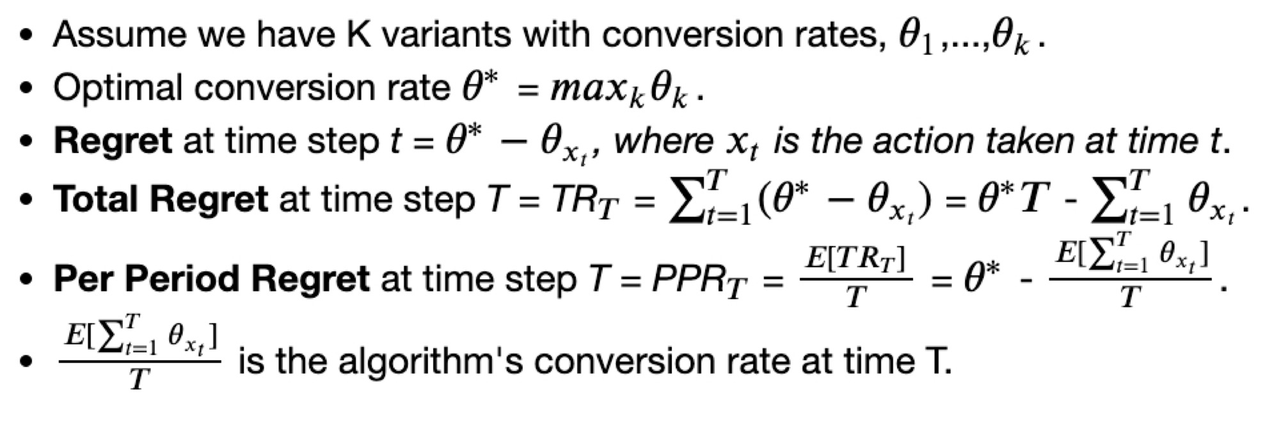
Regret Minimization MAB – Regret

Slide 7
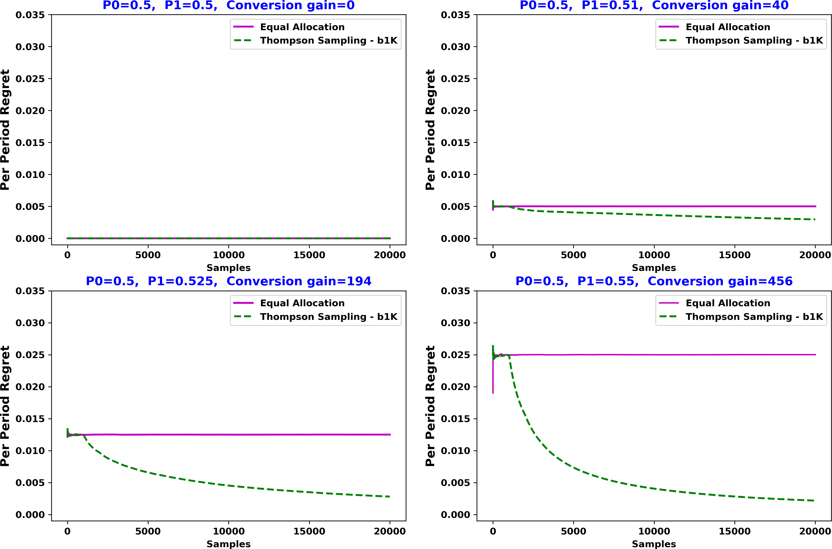
Thompson Sampling – 2 variants

